Slide 1
C Programming Lecture 3 : C Introduction
Lecture notes : courtesy of Woo Kyun and Chang Byung-Mo
Notes:
이 슬라이드는 부산대학교 우균이 작성하였습니다. 오류나 수정할 사항 있으면 woogyun@pusan.ac.kr로 연락 주세요.

Slide 2

C Programming Language
Designed by Dennis Ritchie (1972)
used for developing UNIX OS
C features
Structured programming , modular programming
Highly portable
Efficient (fast)
C has the features of high level language and low level language
Dennis Ritchie

Slide 3
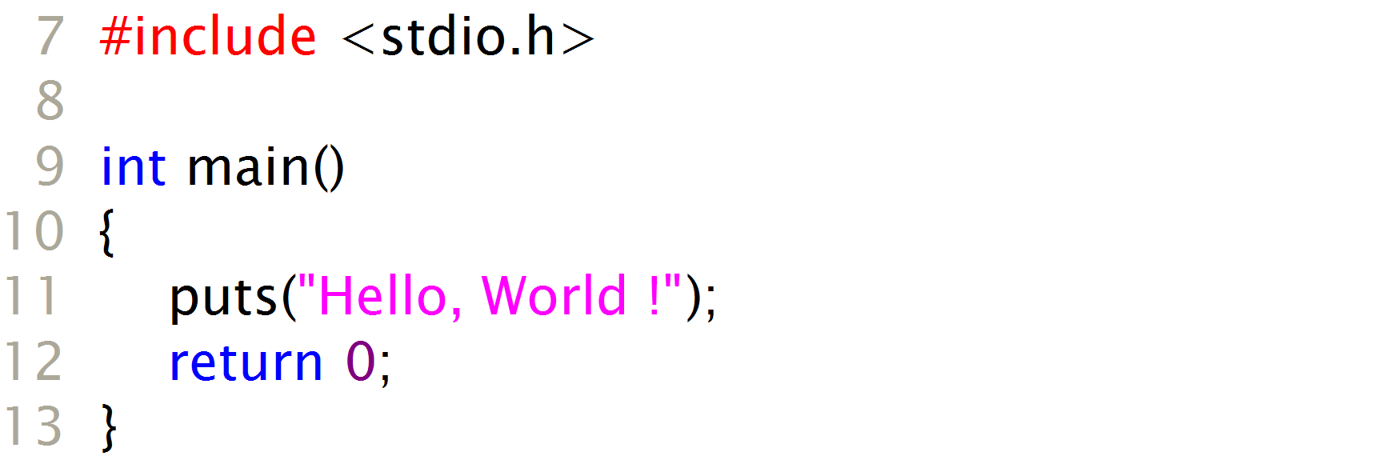
simple C program (hello.c)
output:
Hello, World !

Slide 4
C compiler
compiler?
Programmer can use high level language such as C
CPU knows machine language (assembly language)
C compiler
Commercial compiler: Microsoft Visual C/C++ (ver. 6.0)
Free compiler: gcc
C program
int main…
Compiler
Machine
language
010101…

Slide 5
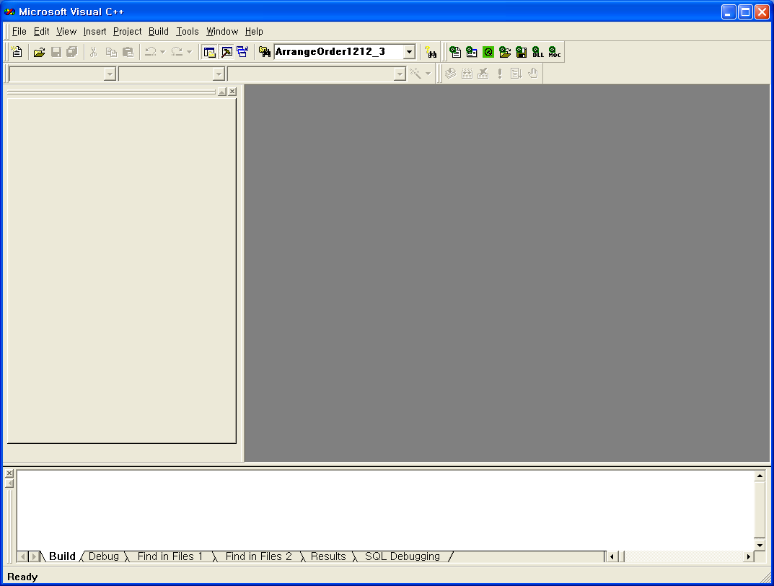
Visual Studio 6.0
Microsoft Visual C++ 6.0
Project window
Editing window
Message window

Slide 6
Program Development
Creating Project
Adding Files
Editing Program
Compile&Build
Execution&Debugging

Slide 7
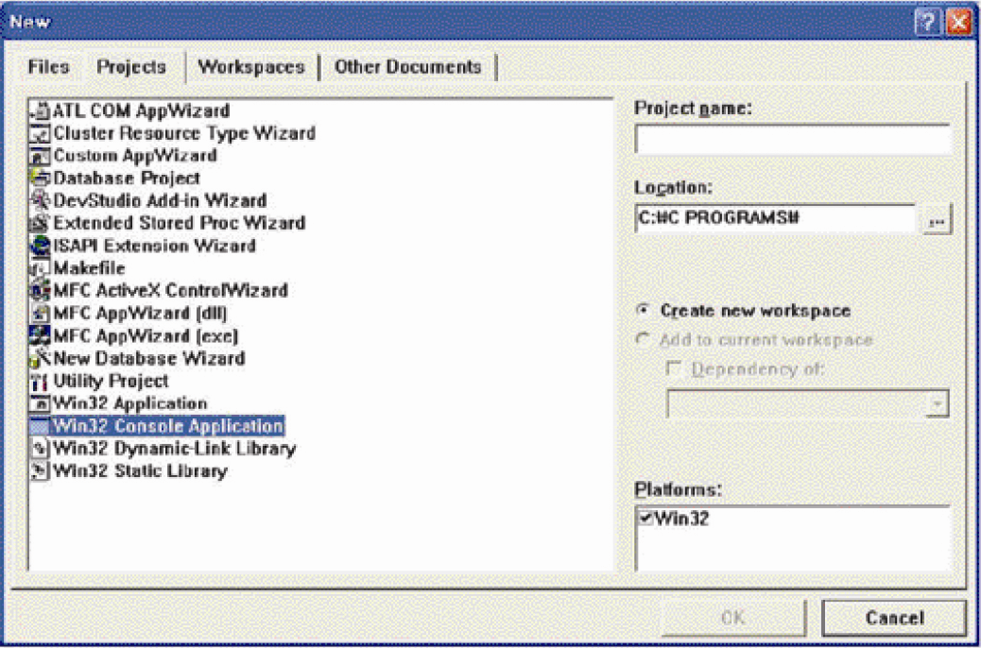
Creating a Project (1/5)
File → New
Projects tab
Win32 Console Application
Location
Project Name
OK
Finish & OK

Slide 8
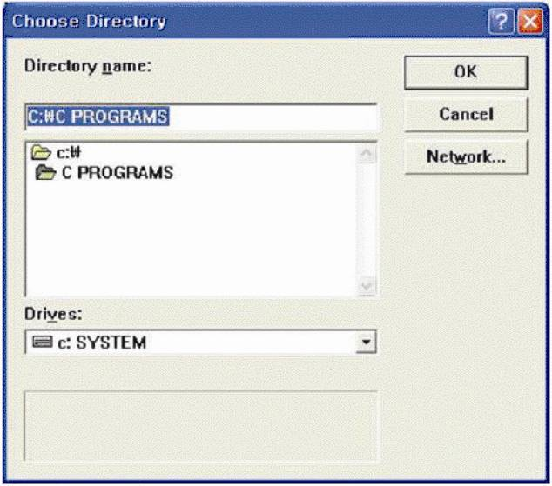
Creating a Project (2/5)
File → New
Location
Folder selection
Project Name
OK
Finish & OK

Slide 9
Creating a Project (3/5)
File → New
Location
Project Name
Hello
OK
Finish & OK

Slide 10
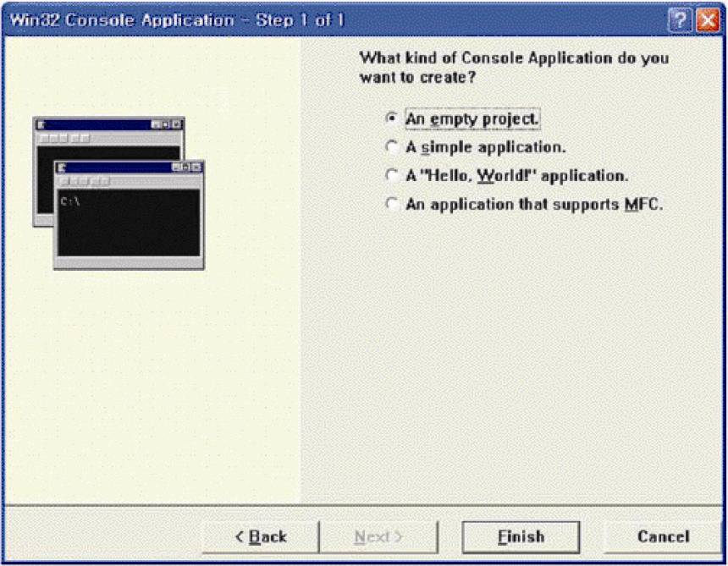
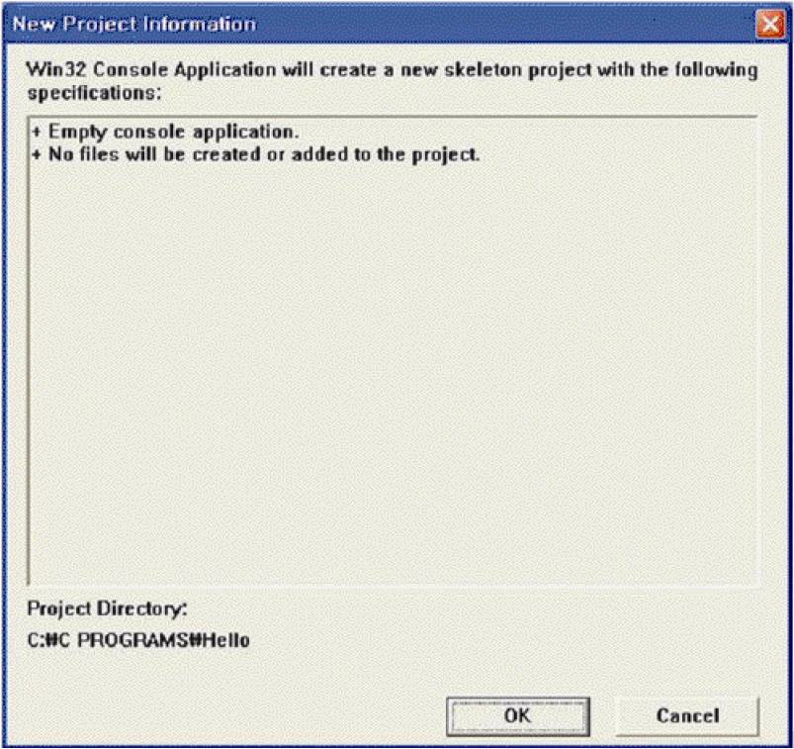
Creating a Project (4/5)
File → New
Win32 Console Application
Location
Project Name
OK
Finish & OK

Slide 11
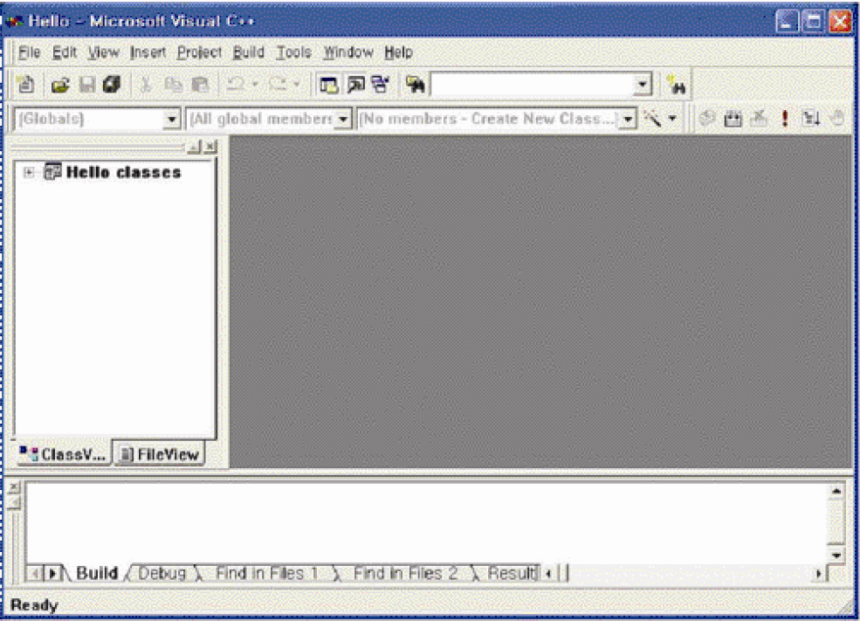
Creating a Project (5/5)
Hello project is created

Slide 12
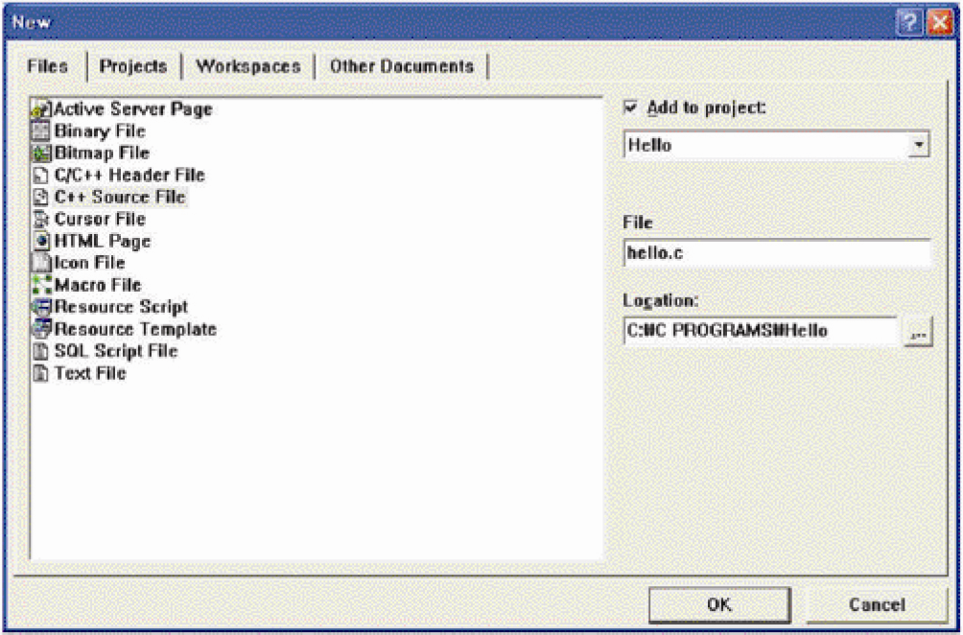
Adding Files (1/3)
File → New
Files tab
C++ Source File
filename
OK

Slide 13
Adding Files (2/3)
File → New
filename
Add to project
hello.c
OK

Slide 14
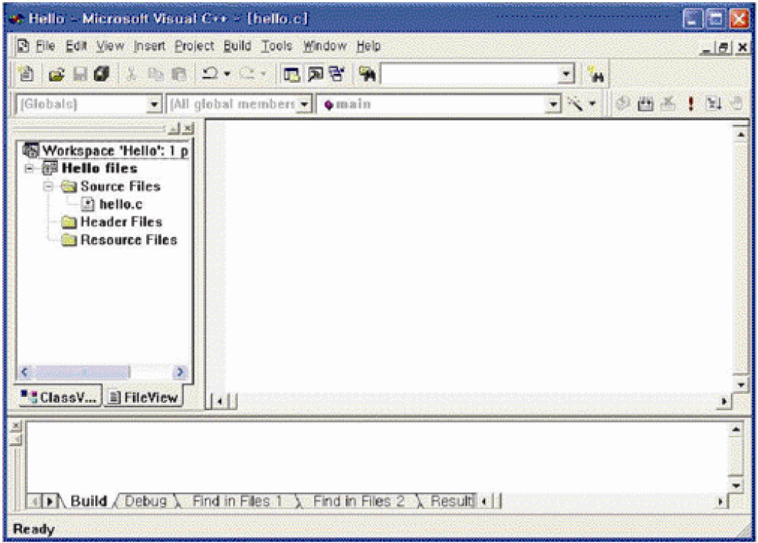
Adding Files (3/3)
Source file hello.c is added to Hello project

Slide 15
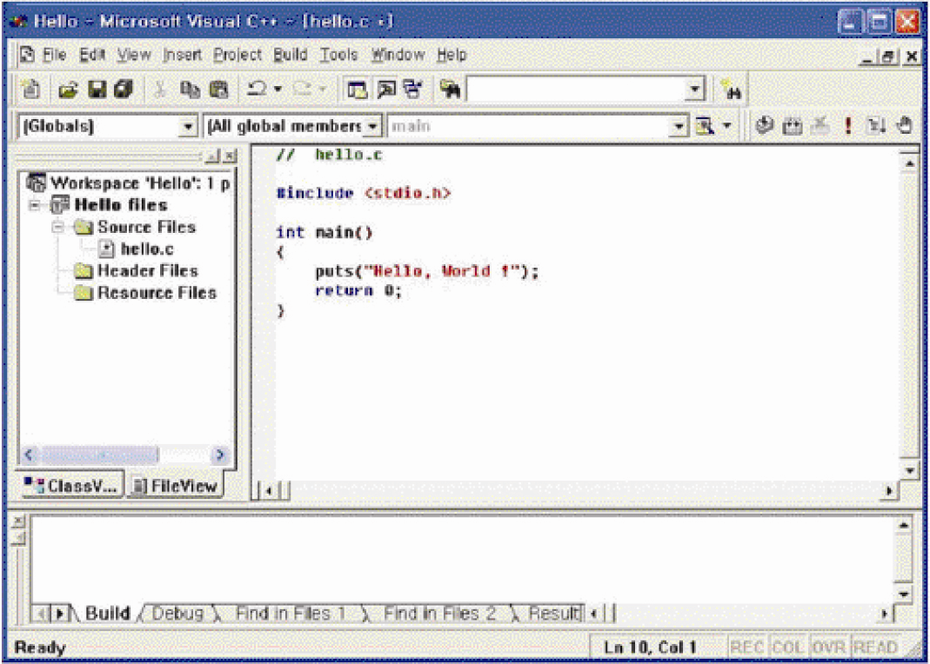
File Edit

Slide 16
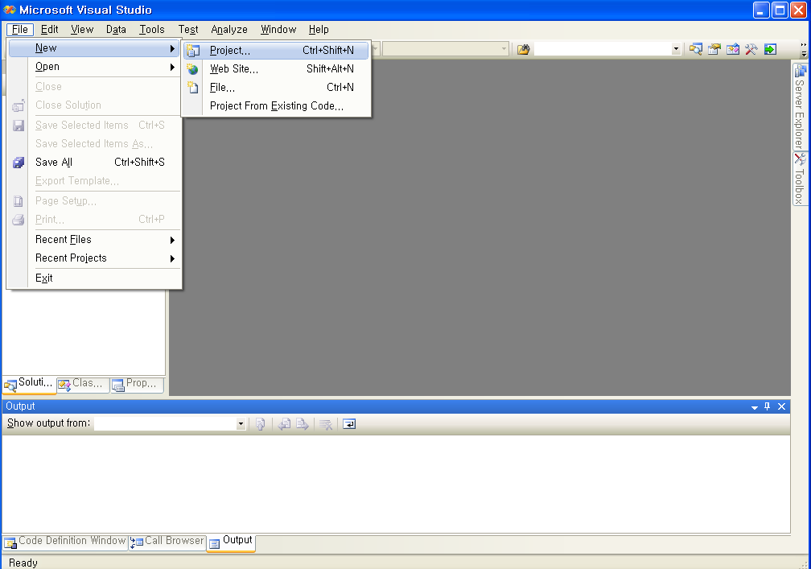
Visual Studio 2008 : Creating Command-Line Program

Slide 17
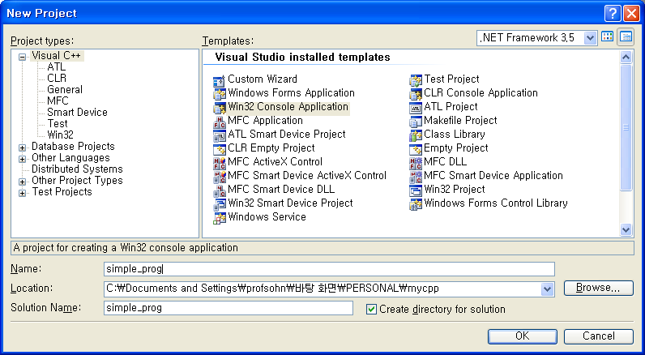
Visual Studio 2008 Creating Command-Line Program

Slide 18
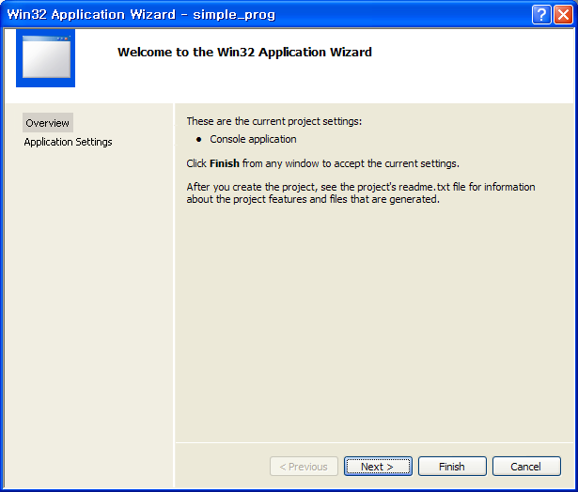
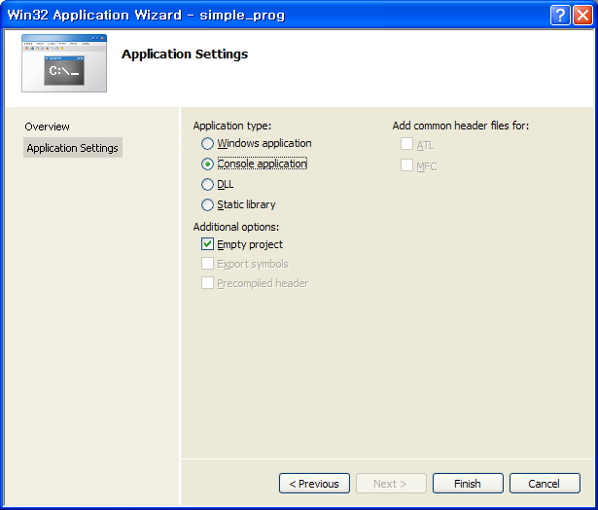
Visual Studio 2008 Creating Command-Line Program

Slide 19
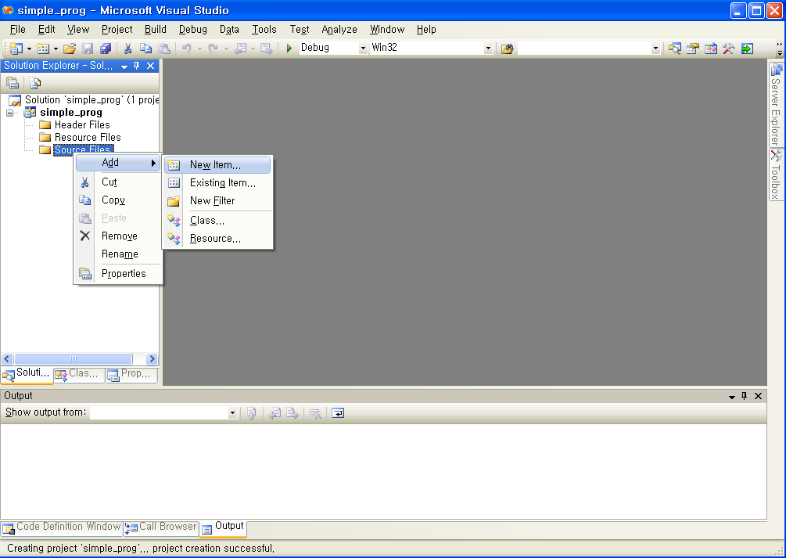
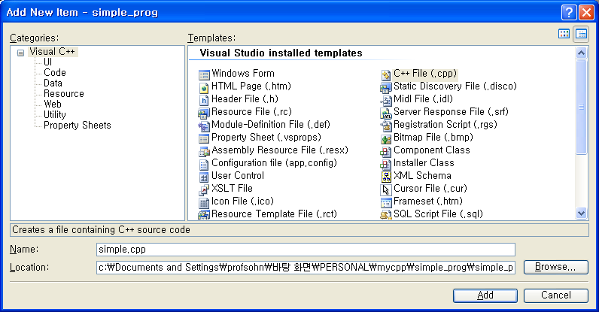
Visual Studio 2008 Creating Command-Line Program

Slide 20
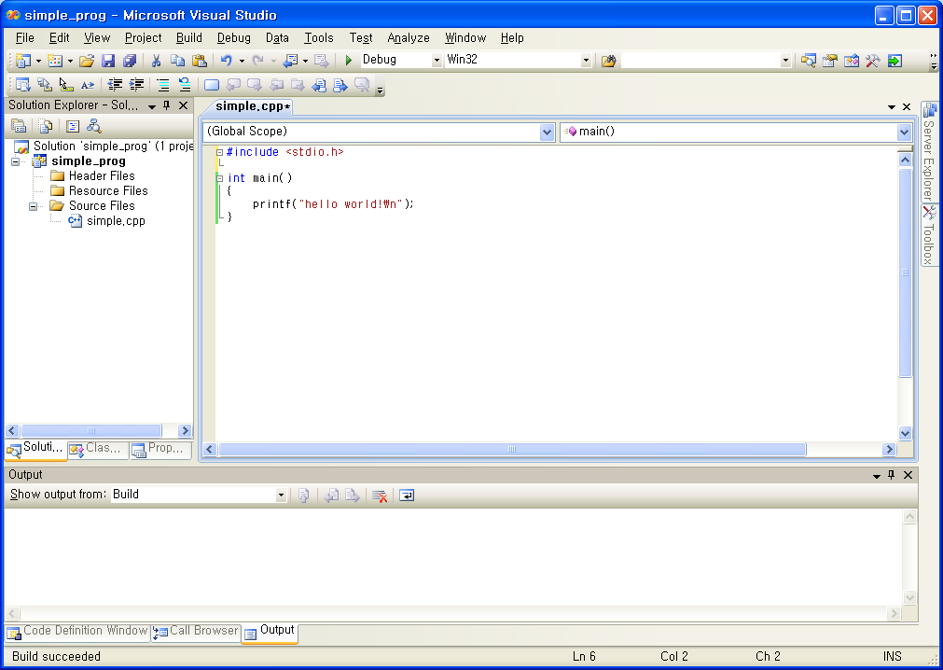
Visual Studio 2008 Creating Command-Line Program

Slide 21
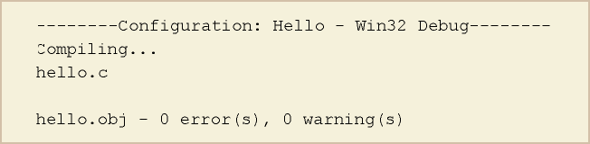
Compile & Build
compile → Compile hello.c
Object file (.obj) is created
Build → Build Hello.exe
Link : link object files and create a executable file (.exe)

Slide 22
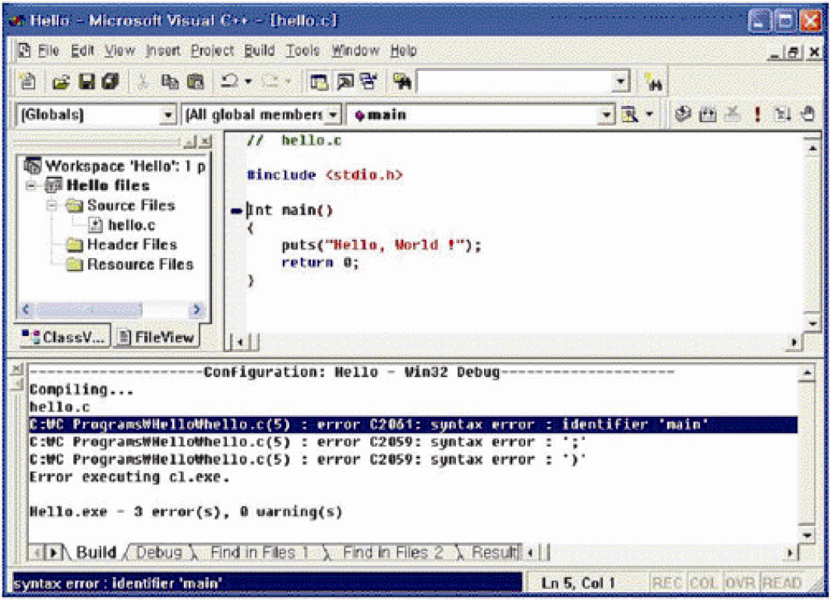
Compile-time error
Grammar error. Object file can not be created
Double click error message line

Slide 23
Programming Process
Source files (.c)
preprocessor
temporary program texts
compiler
Object files
library files
linker
Executable file (.exe)

Slide 24
gcc / g++
Free C/C++ compiler developed by GNU

